Slide 1
Project 4 – Car pricing predictor
Colin Roberts
Mitchell hatchett
Jaylen whittaker
Connery hinson
Paul anderson

Slide 2
Project summary
The “Car Price Analysis and Prediction” project involves delving into a dataset encompassing various attributes of used cars, ranging from price and make to fuel type (electric, hybrid, gasoline), color, and horsepower. Through data analysis, we aim to uncover the key factors influencing car prices. Moreover, predictive modeling will enable us to estimate the price of cars based on their attributes, empowering private sellers and dealers to make informed pricing decisions. The data could then be used by an automobile seller as a guide on how to target their customer base and maximize sales.

Slide 3
Process
Find and clean the data, using pandas, create a few visualizations to ensure the data is clean and usable. Create csv files for export and use in the next step
Use a PostGreSQL database to create and join tables, the goal being to have all the pertinent data contained in one or two tables. Perform basic queries to ensure data integrity
Create visualizations in Tableau
Create machine learning model, probably in Colab Jupyter Notebook to handle the predictive analysis that is the ultimate goal of this study.
The interactive piece would allow a seller to input information about their car, and get an estimate of what it would sell for on the market.

Slide 4
Data cleanup
We used several csv files from various sources.
Used pandas to clean up the files, dropping some irrelevant columns, adding an index in some cases.
Code for the cleanup found in the repository

Slide 5
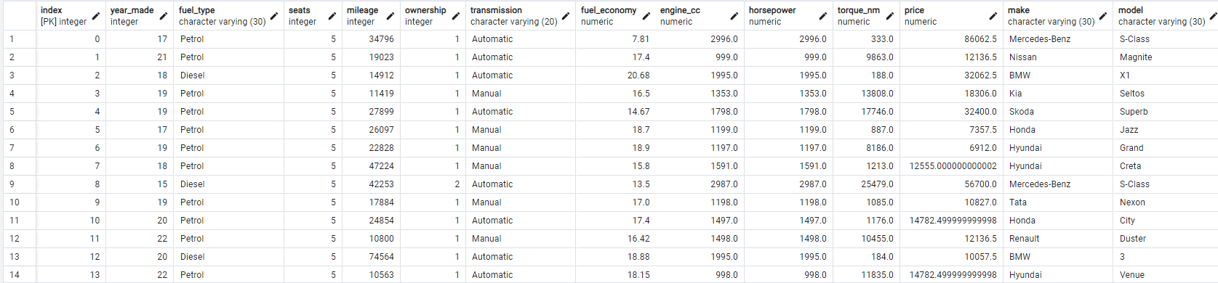
SQL DAtabase
After the data were cleaned, we created a SQL database for easy queries and to check the quality of the data. Three tables were eventually used. This one took into account items like horsepower and number of owners

Slide 6
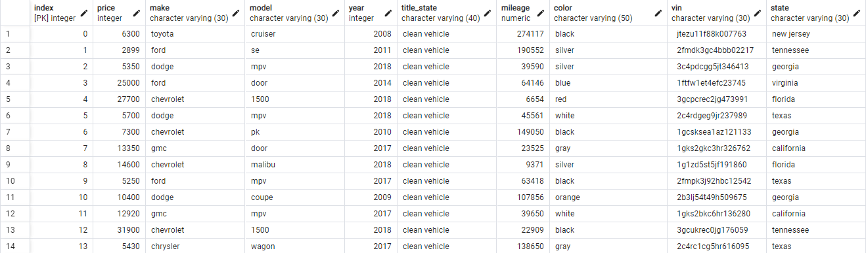
Second table
This table added additional parameters like color and state

Slide 7
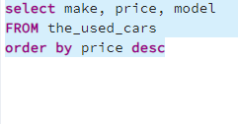
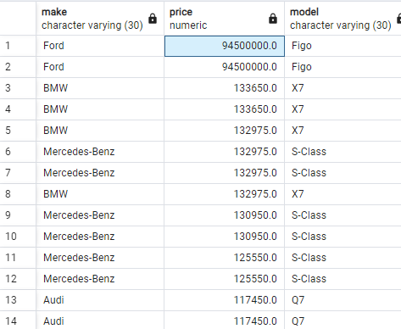
The SQL database made it easy to spot outliers and possible mistakes in the data, and we used the clean tables for our machine learning model, visualizations and the interactive parts of our projects as well.
What is a Ford Figo and why does it cost $94.5 million? Obviously an error in the dataset.

Slide 8
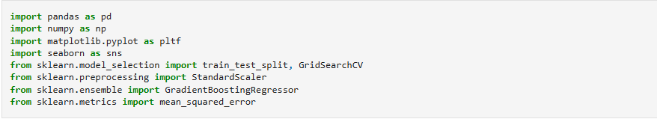
The machine learning model

Slide 9
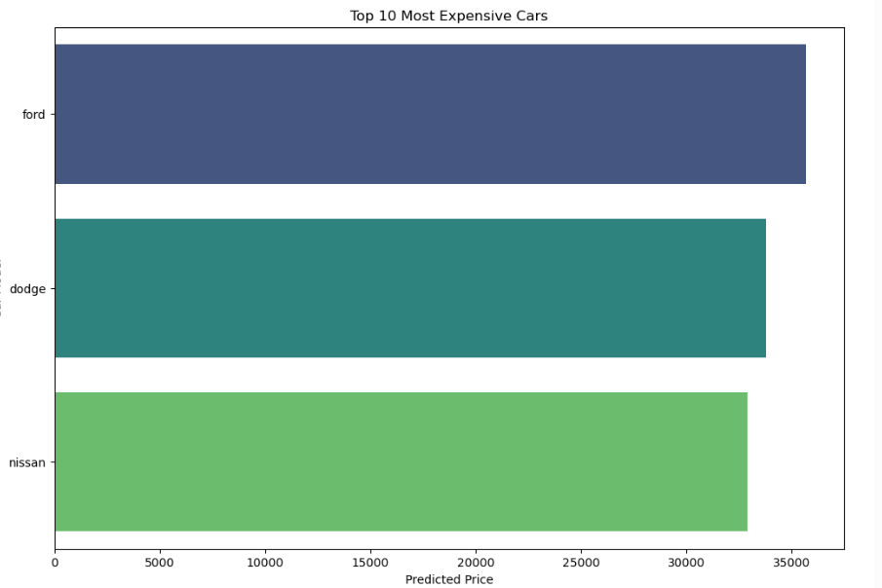
We used our cleaned data in python/pandas to construct a model to predict the price of used cars, and compared our predictions to the data

Slide 10
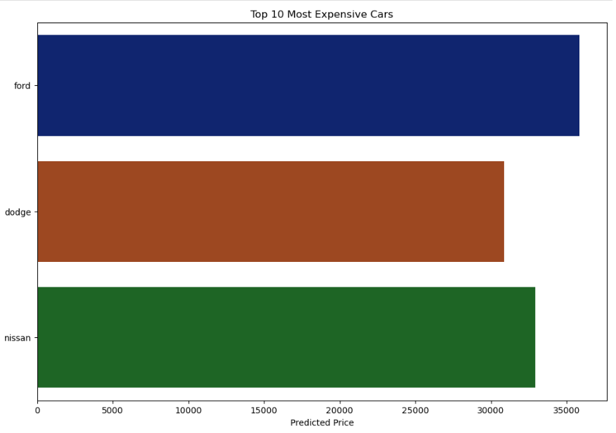
Refining the model

Slide 11
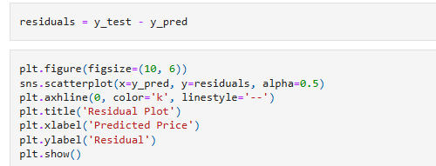
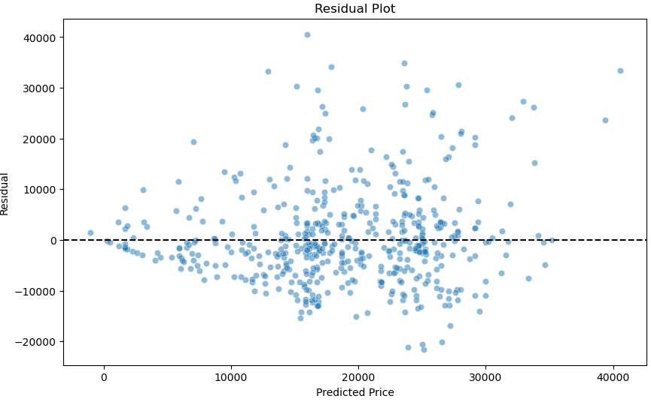
A residual plot of the model

Slide 12
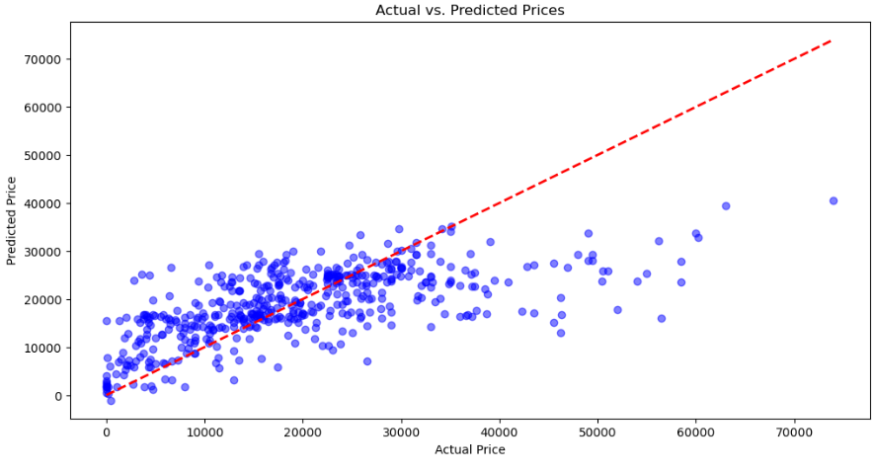
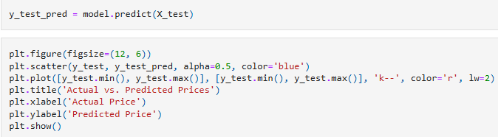
A plot of actual vs. predicted prices

Slide 13
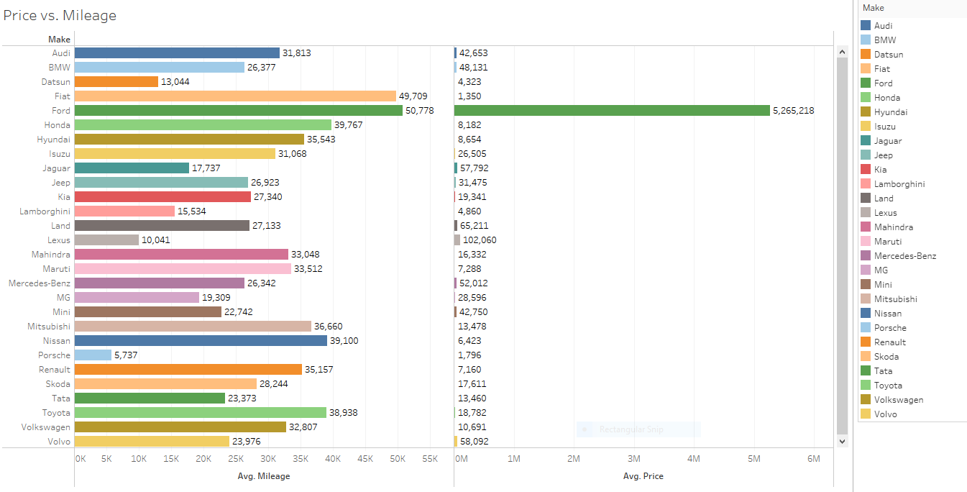
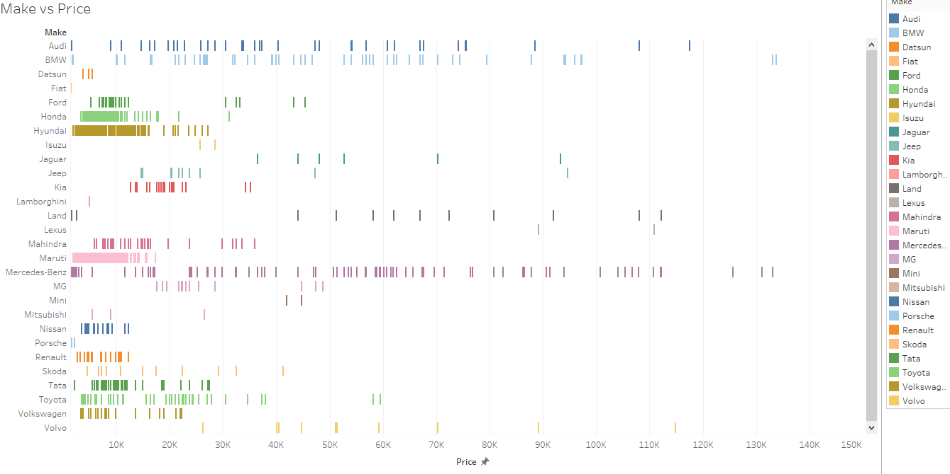
Next, we used the data to create visuals in Tableau. Here are some examples. The rest can be found at the link to tableau public in the repository

Slide 14
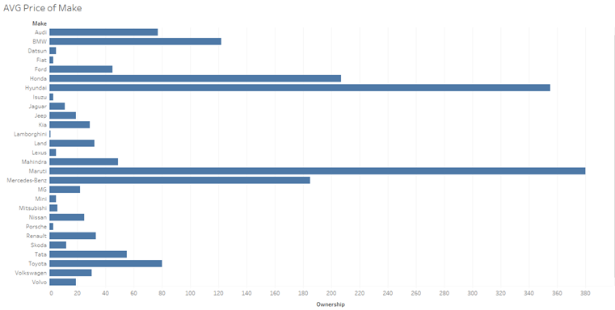
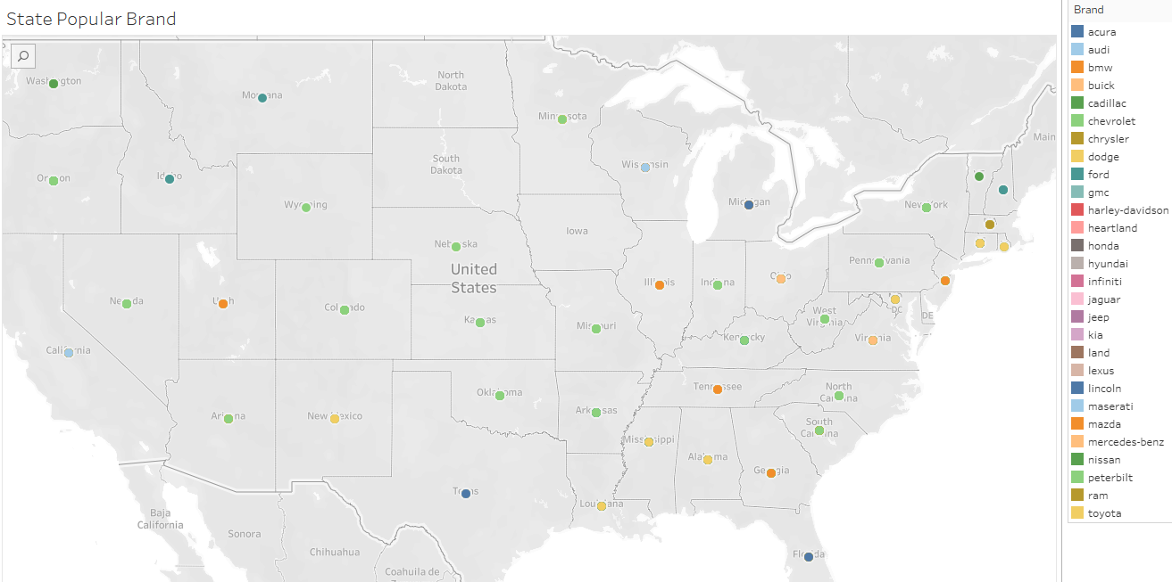
Visualizations

Slide 15
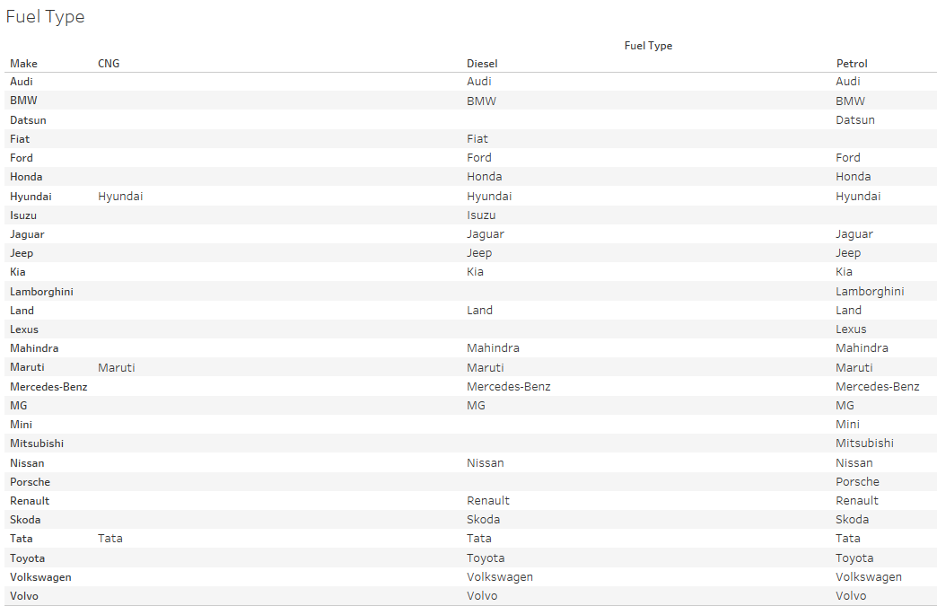
Visualizations

Slide 16
results and features
Using a combination of datasets and APIs from sources on the internet, we were able to construct a machine learning model that accurately predicted the price of a used car based on various criteria, such as price, make, model, and year.
We were able to construct visualizations to illustrate the model
We were also able to incorporate an interactive link, where users could estimate the value of a car they were trying to sell, based again, on similar criteria that they input

Slide 17
Questions

